Slide 1
DATA HANDLING

Slide 2
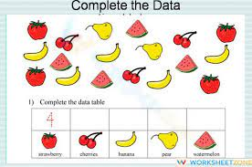
COLLECT AND SORT OBJECTS

Slide 3
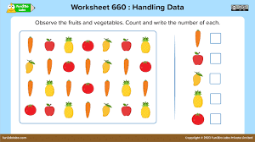
Count the fruits and vegs and write the number of each

Slide 4
Reference

